Slide 1

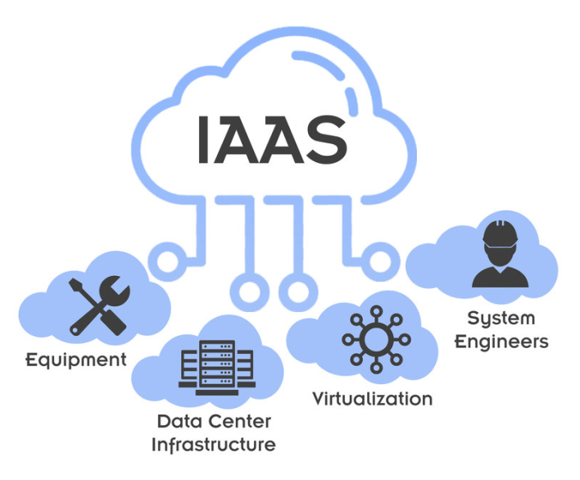
Lab 02 - Private Cloud
https://bit.ly/3WDka3C

